Slide 1





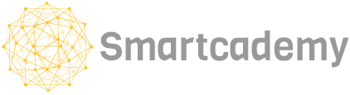
Suara Hati
The little voice in your heart to get you checked up!
pilid | Matheus Aaron
| Nadya Devani

Slide 2
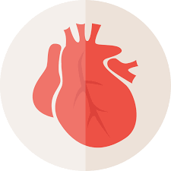
Problem: Cardiovascular Diseases (CVD) in Indonesia
Stroke and ischemic heart disease are two most common causes of death in Indonesia both in 2007 and 2017 (healthdata.org)
Less than 25% of primary health care centres offered CVD risk stratification (risk assessment) in 2017 (WHO)
Less than 50% of health care facilities utilised CVD guidelines

Slide 3
Without proper CVD risk assessment in rural areas, it would be hard to diagnose potential CVD
Consulting a doctor through mobile apps or phone calls would certainly help, but...
If there is a fast way for people to self-diagnose with potential cardiovascular diseases, people will be informed and will be less prone to cardiovascular diseases.

Slide 4
Problem Statement
How might we pre-diagnose a patient based on its self-description of its symptoms?

Slide 5
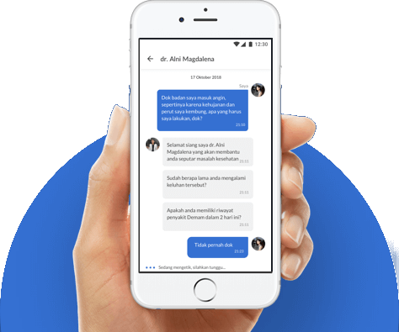
Dataset: Alodokter
Alodokter is a Indonesian healthcare superapp where users can post the queries with certified doctors regarding their complaints.

Slide 6
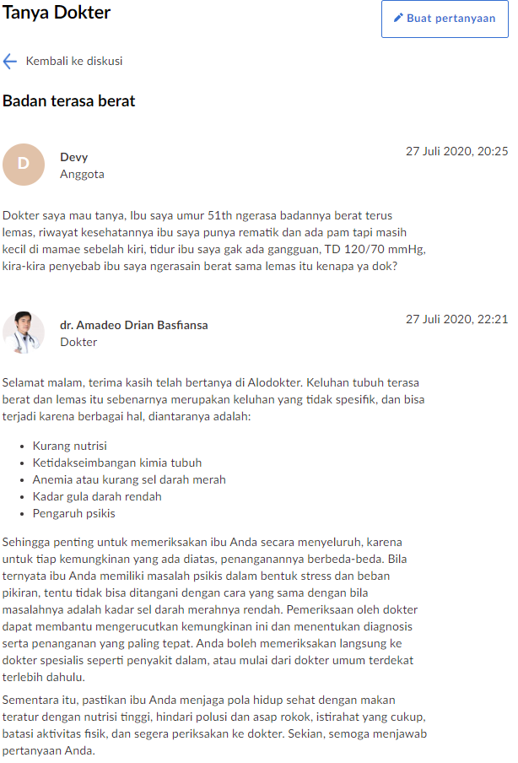
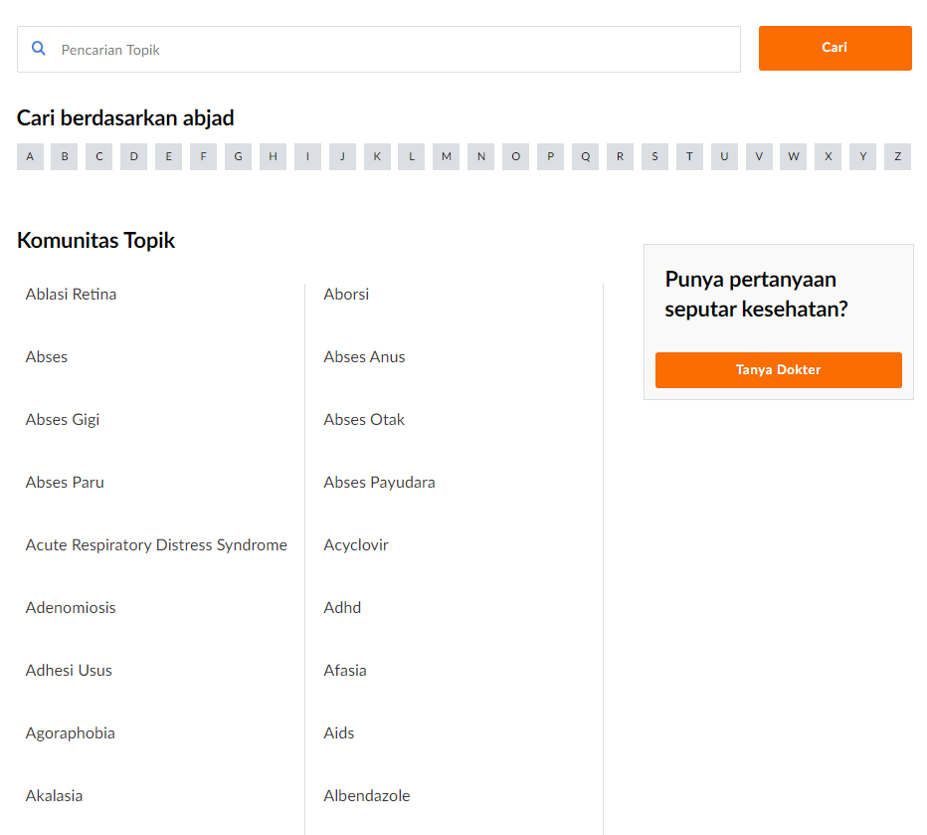
Komunitas Alodokter (Alodokter Community)
Komunitas Alodokter is a forum where users can post medical questions and will be answered by Alodokter’s verified doctors.
There are 1213 categories of posts. Categories include medical problems, drugs, and treatment.

Slide 7
Proposed Solution
Indonesia | English
penyakit jantung bawaan | Congenital heart disease
penyakit jantung koroner | coronary artery disease
kardiomiopati | cardiomyopathy
penyakit katup jantung | valvular heart disease
stroke | stroke
trombosis vena dalam | deep vein thrombosis
penyakit arteri perifer | peripheral arterial disease
aterosklerosis | atherosclerosis
gagal jantung | heart failure
aritmia | arrhythmia
serangan jantung | heart attack
Given the user complaint, predict the diagnosis.
The diagnosis here is the category of the post.
The scope of the project is limited to the following most 11 common cardiovascular diseases:

Slide 8
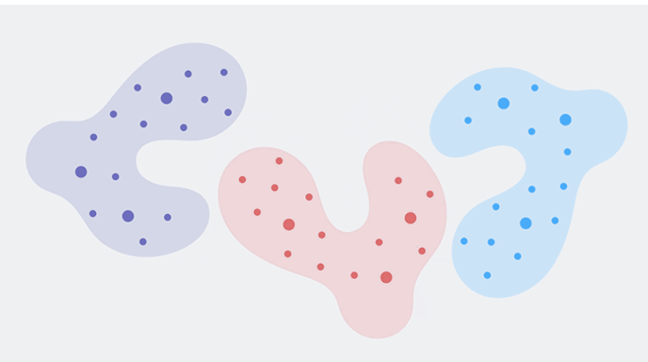
Proposed Model: BERT
Each dot is representing a word in a vector space.
The distance between words shows the relations.
Bidirectional
Encoder
Representations from
Transformers
New method of pre-training language representations using bidirectionality of Transformers

Slide 9
BERT-Base
For this project, we will use a pre-trained model provided by Google to save computational power.
It is trained on...
104 languages
12-layer
768-attributes
12-heads
110M parameters
Multilingual Cased

Slide 10



Why BERT?
Bidirectionality
It can understand the context of a sentence from the left and from the right. Bag of Words and TF-IDF does not encode context while other neural networks tend to be unidirectional (context is only provided from preceding words).
Transfer Learning
The model has been trained on huge corpus of data. It does not have to learn from zero from the training data alone. This has been observed in computer vision and currently being applied in natural language processing.
Fast
It is significantly faster compared to LSTM as it can process the tokens concurrently and does not have to wait from preceding tokens.

Slide 11
The project consists of three stages: data collection, feature engineering, and modelling.
Scrape data from Alodokter.com
Remove common words
Fine-tune BERT on training data and evaluate on test set
Using request, BeautifulSoup, and json, scrape user posts in each category.
Users love to use pleasantries.
For example:
Selamat pagi (Good Morning)
Halo dok (Hello, doc)
etc.
Remove these phrases as they add no valuable information.
Fine-tune BERT’s pretrained weights with the supervised training dataset.
Neural network does not need evaluation dataset as it will auto-finetune from its training dataset.

Slide 12
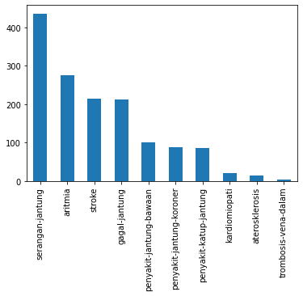
Train Dataset Profile
diagnosis | count | proportion
serangan-jantung | 436 | 30%
aritmia | 275 | 19%
stroke | 214 | 15%
gagal-jantung | 213 | 15%
penyakit-jantung-bawaan | 101 | 7%
penyakit-jantung-koroner | 87 | 6%
penyakit-katup-jantung | 86 | 6%
kardiomiopati | 20 | 1%
aterosklerosis | 14 | 1%
trombosis-vena-dalam | 4 | 0%
Grand Total | 1450 | 100%

Slide 13
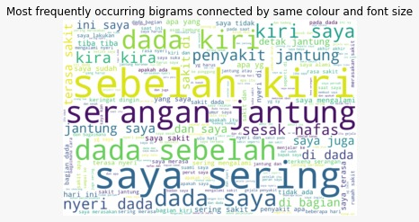
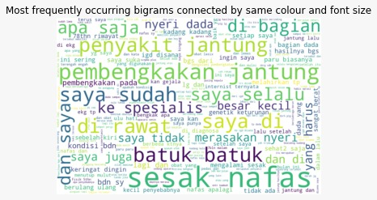
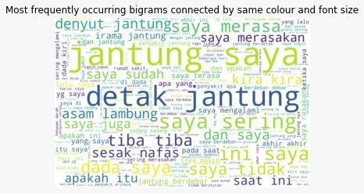
Heart Attack
Heart attack
arrhythmia
cardiomyopathy
Here’s how users described their symptoms.

Slide 14
63.08%
After cleaning the data, we achieved an accuracy on multi-class labelling of 63.08% on the test dataset. We were unable to obtain the ROC curve.

Slide 15



Despite high performance, there are some flaws.
Noisy Data
Some of the user posts are more about general medical enquiry rather than asking for diagnosis.
Wrong Diagnosis
The category of the post might not be the actual diagnosis. Actual diagnosis should be extracted from the answer of the doctor.
Inconclusive Diagnosis
Sometimes, the symptoms may not be clear and may lead to multiple diseases that shares the same symptom.

Slide 16
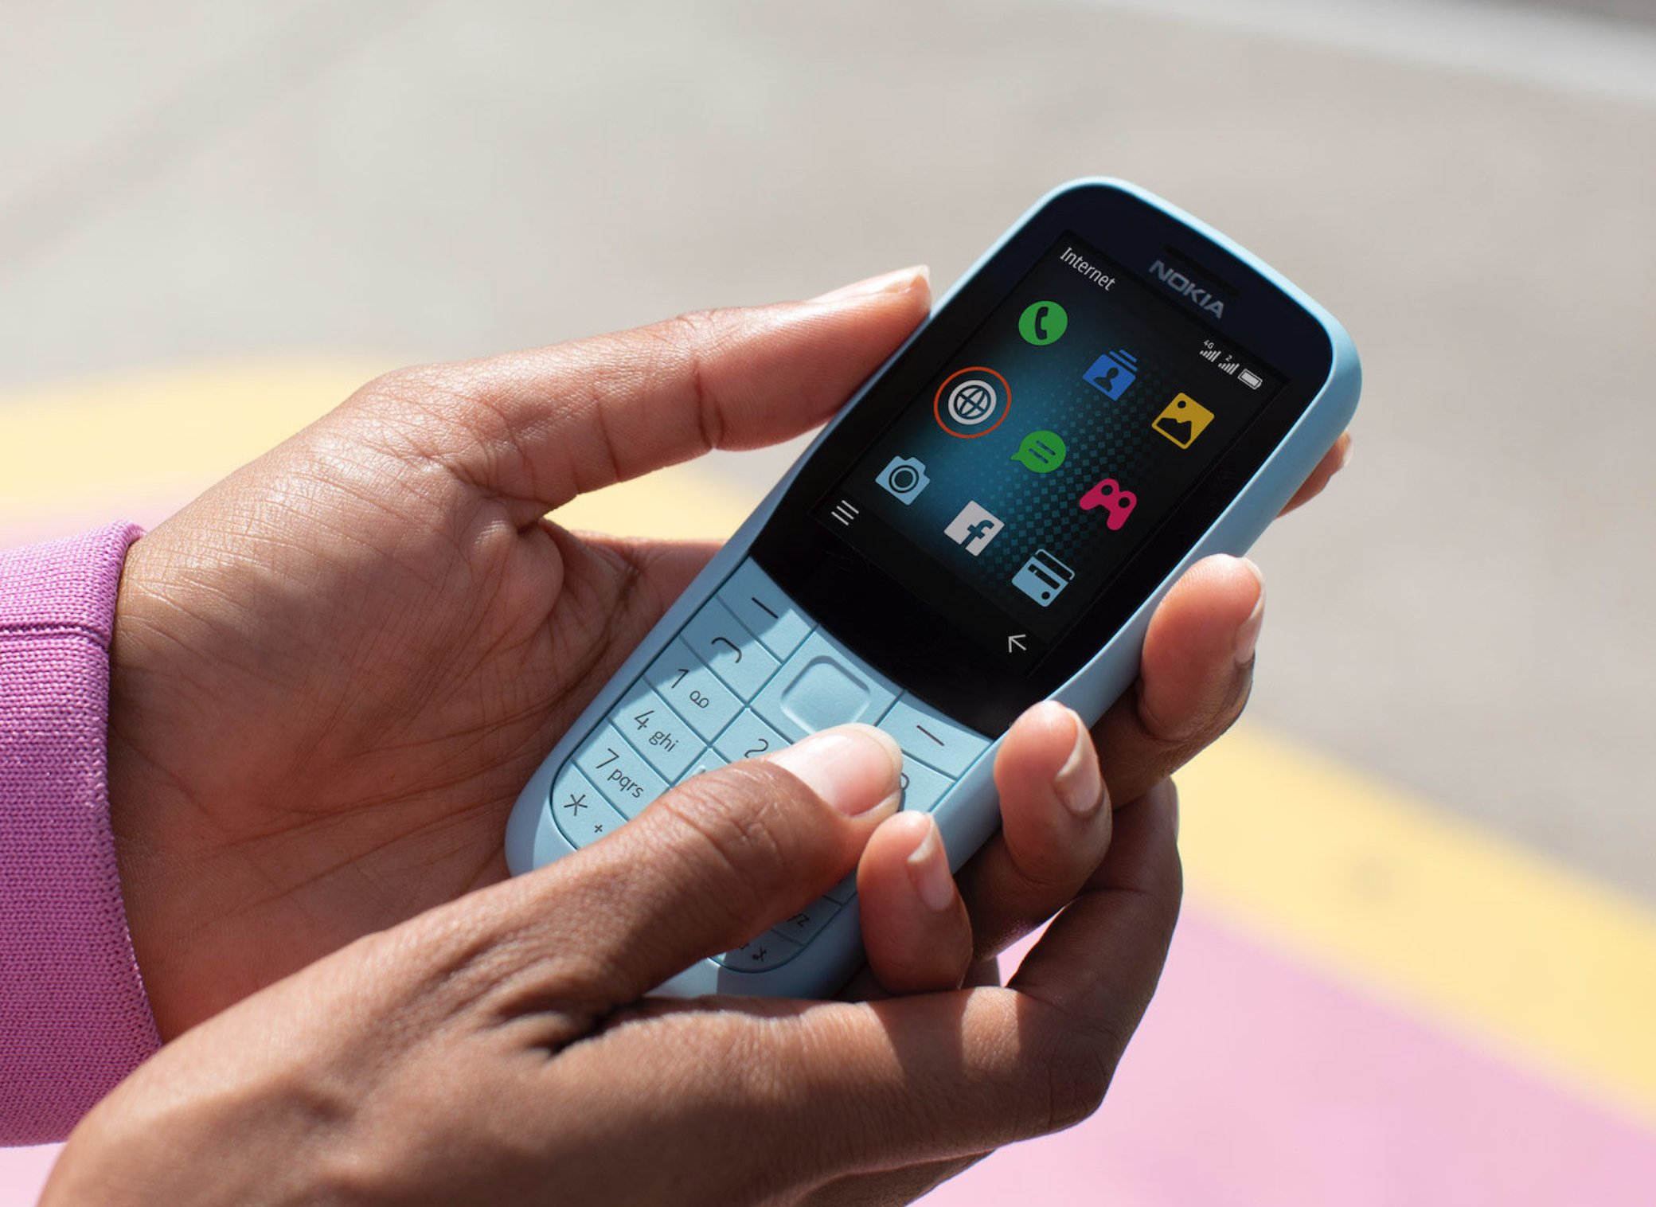
Use case
Call Dr. AI
People with no access to internet and poor access to healthcare providers can call Dr. AI, then the patient’s voice will be transcribed to be diagnosed.
A telemedical platform to get swift diagnosis

Slide 17
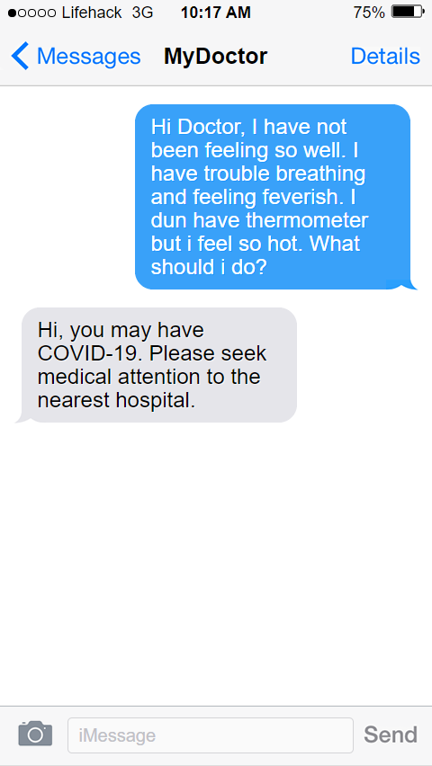
Use case
Text Dr. AI
People with no access to internet and poor access to healthcare providers can text Dr. AI.
A telemedical platform to get swift diagnosis

Slide 18
Use case
Government Health Condition Monitoring
Relevant authorities are able to map the medical conditions faced by each area. Geolocation can be obtained from the citizen’s texts and calls.
Health authorities will then be able to allocate resources more efficiently.
A way for Ministries of Health around the world understand health condition of its citizens

Slide 19
If we had more time, these are the things we would like to try out and recommend others to do so.
Better data cleaning
Explore other multilingual natural language models such as
BERT-Malay
XLM-RoBERTa
Explore sliding window to retain the whole text of information
Work on multi-label classification
Extract the diagnosis from the doctor’s response instead of the category by using Biomedical Name-Entity Recognition (NER).
Extend the prediction to diseases other than cardiovascular diseases

Slide 20
Reflection and Conclusion
The results from this project may fell short of what we needed, but it certainly shed some hope on a future where healthcare can be more affordable with AI as doctors. This project is certainly a proof of concept that this is possible. This will serve those on the margins better as they have less access to proper healthcare.
As more data is generated every hour on platforms like Alodokter, we believe that one day, we will have an open source AI general doctor that will be able to at least provide a pre-diagnosis to patients and prompt them to visit the nearest healthcare facility. This project will increase the public’s interest in healthcare and we, as a society, will move forward healthier together.

